Slide 1



Step 1
Creating a configuration
General tab
You can choose your hotspot name. This will be use for both the network
and the URL to access your content (e.g. http://bobs.hotspot or http://home.hotspot).
www.kiwix.org

Slide 2

Step 2
Configuration
Branding tab
Personalise with your identity
Y O U R L O G O
Default appearance
You can also add your own logo.
www.kiwix.org

Slide 3
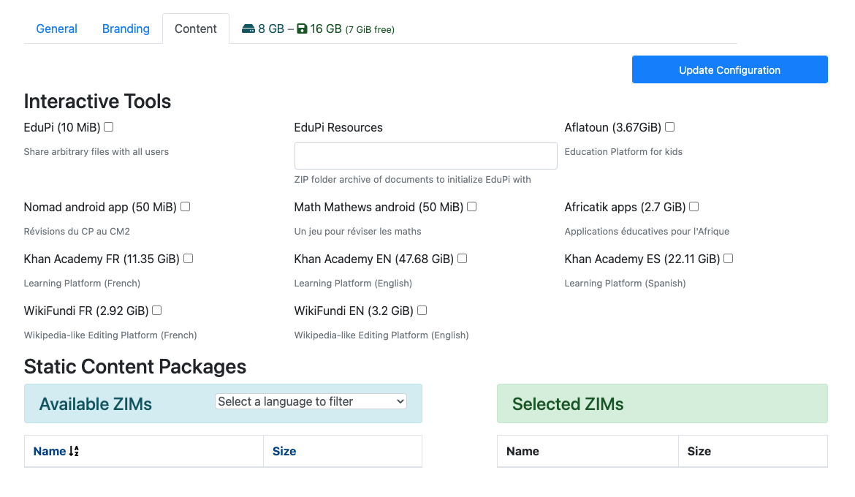
Step 3
Configuration
Content tab
This shows how much content you have been using (8GB are already taken by the Raspbian OS)
This shows how big your SD card needs to be.
Click here to save your
configuration
www.kiwix.org

Slide 4
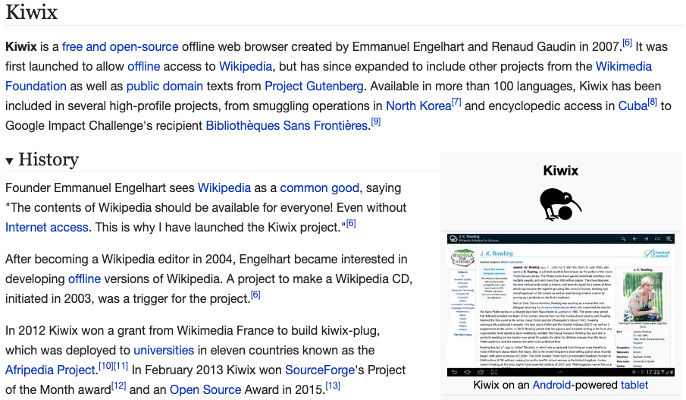
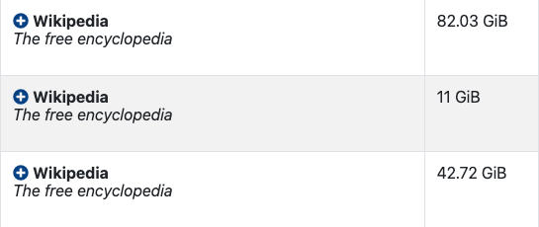

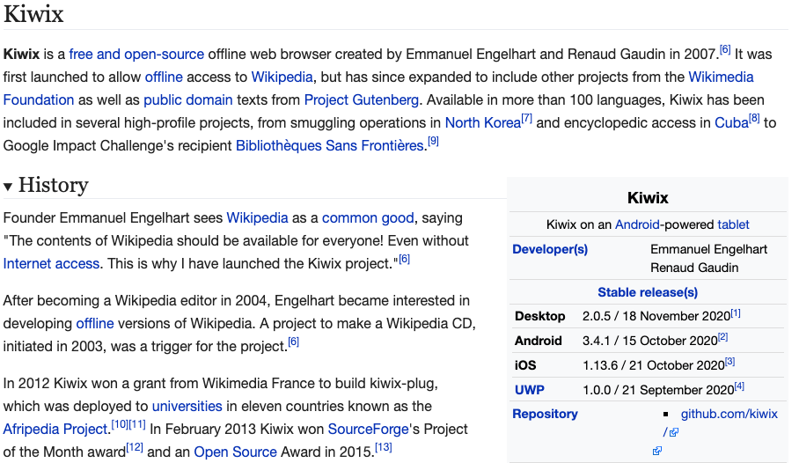
Step 4
ZIM selection
Content tab
1. Maxi
All content included.
2. Mini
Lead part of articles included, without imagery
3. Nopic
No imagery included.
Some files come in threes. This is to help you save on storage. Research has shown that 60% of Wikipedia reader found the information they needed in the lead section.
www.kiwix.org

Slide 5

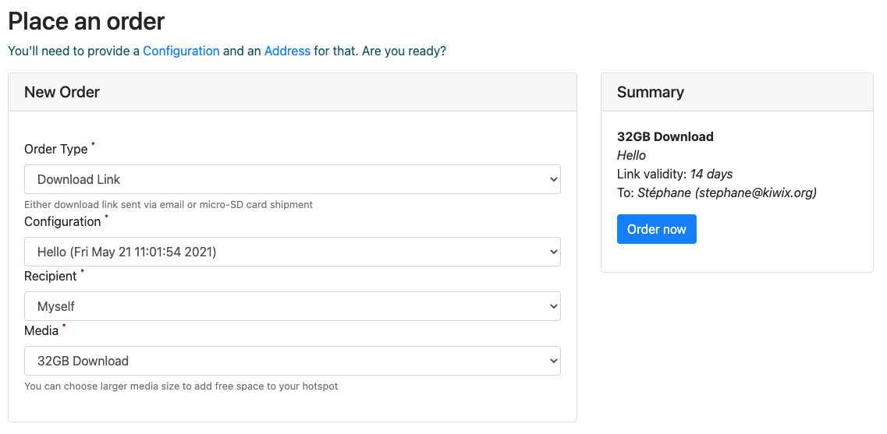
Step 5
Place an order
Order tab
Ensure that the correct configuration is selected
Size of the SD card you will need
You will then receive a confirmation email.
Image creation usually takes a few hours, please be patient !
www.kiwix.org

Slide 6
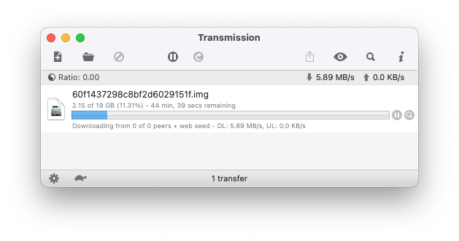



Step 6
Downloading an image
Your image is ready to download!
Dear John Doe,
Your Hotspot Image “Home” is now ready to download.
We recommend using Transmission, a BitTorrent manager that does not require any specific installation.
Simply download the torrent link and open it with Transmission. If your computer or connection crashes during the download, it will resume automatically.
Direct downloads, particularly for very large file, are sometimes unstable
Download it at www.transmissionbt.com
It’s free!
After a couple of hours you will get an email with a download link.
www.kiwix.org

Slide 7
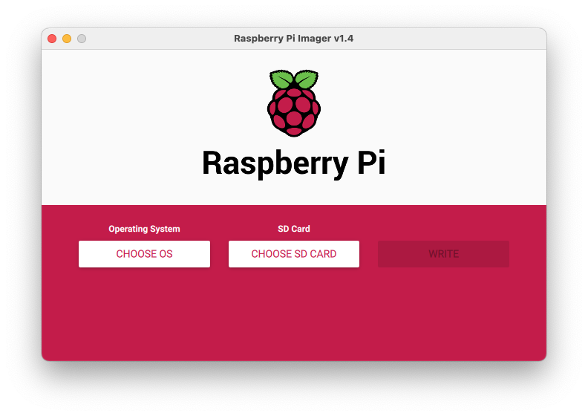
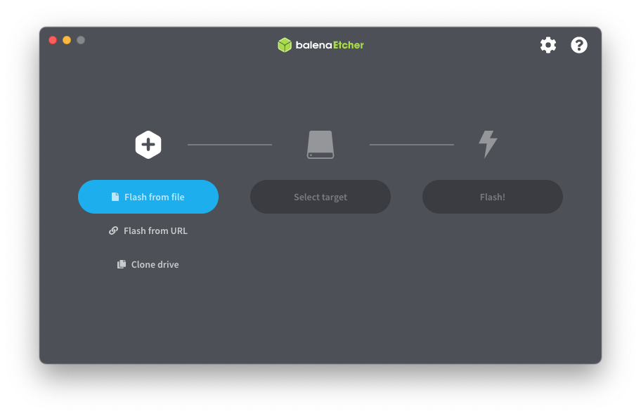
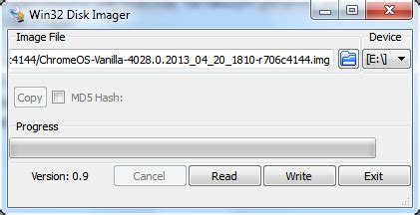
Step 7
Flashing your image onto a microSD card
There is a bunch of free resources available such as Balena Etcher, Raspberry Pi Imager or Win32 Disk Imager. Simply select the .img file and the SDcard, then click on “write”.
www.kiwix.org

